Slide 1

Hotel
Aggregator
Analysis
- Power BI Visualization

Slide 2
Problem Statement
Objective:
Analyze hotel aggregator listings to uncover trends, patterns, and performance factors.
Dataset Attributes:
- Listings
- Hosts
- Reviews
- Availability
Key Metrics:
- Pricing
- Availability
- Host Characteristics
- Review Scores
Tools:
- Power BI for comprehensive visualizations and insights

Slide 3
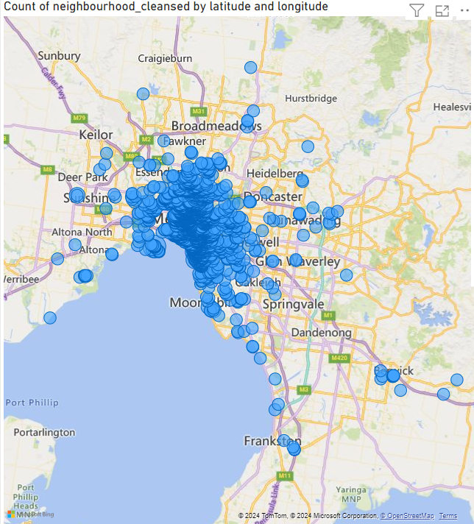
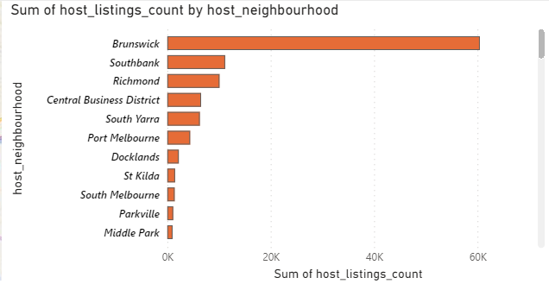
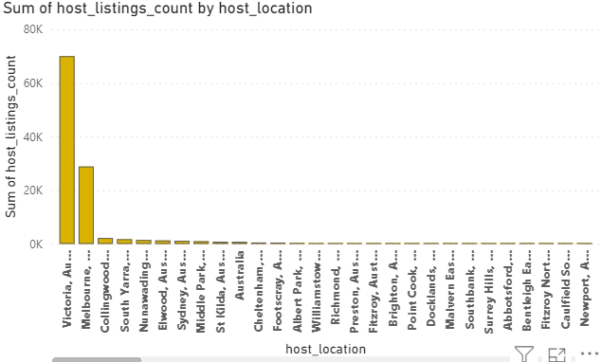
Geographical Insights

Slide 4
Geographical Insights
Geographical Insights from Visualizations
1. Listings Concentration by Latitude and Longitude:
The first map shows a high concentration of listings in the central areas of Melbourne.
Key clusters are visible around the city center and surrounding neighborhoods, indicating popular areas for listings.
2. Host Listings Count by Location:
Victoria, particularly Melbourne, dominates the listing counts.
Other locations show significantly lower listing counts, emphasizing Melbourne's centrality in this dataset.
3. Host Listings Count by Neighborhood:
Brunswick leads with the highest number of listings, followed by Southbank and Richmond.
Central Business District and South Yarra also have notable counts, indicating these neighborhoods are popular for hosts.
Summary
Central Melbourne is the primary area with dense listings.
Victoria and Melbourne are the leading regions in terms of host activity.
Brunswick, Southbank, and Richmond are the top neighborhoods, suggesting high demand or host activity in these areas.

Slide 5
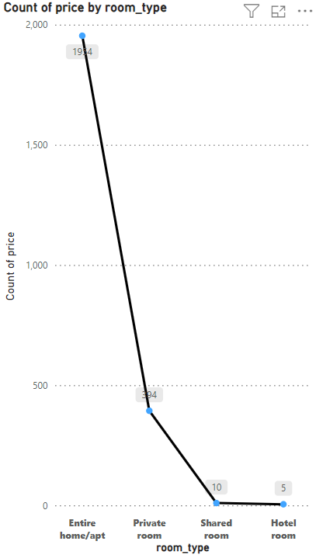
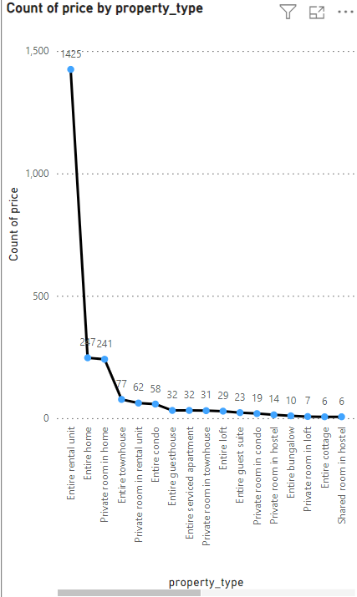
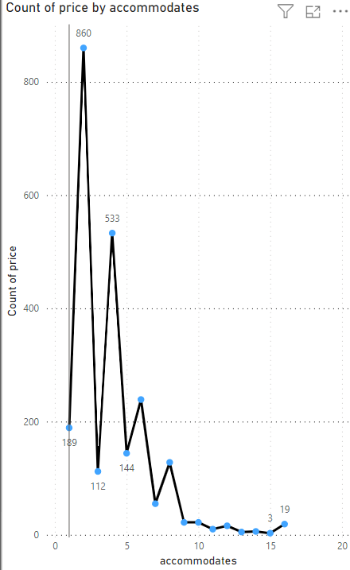
Pricing and Availability Analysis

Slide 6
Pricing and Availability Insights
1. Pricing and Availability by Room Type
Entire home/apt: The most common option, with 1,914 listings.
Private room: The second most common, with 394 listings.
Shared room: Much less common, with 10 listings.
Hotel room: The least common, with 5 listings.
Insight: Entire homes/apartments are the most available, while shared and hotel rooms are scarce. Pricing is likely to vary with availability.
2. Pricing and Availability by Property Type
Entire rental unit: The most frequent type, with 1,425 listings.
Entire home: Second most common, with 241 listings.
Private room in home: 77 listings.
Entire townhouse: 62 listings.
The rest (various types like entire loft, entire guest suite, etc.) have fewer listings, with most property types having below 10 listings.
Insight: Entire rental units dominate the market, suggesting they are the most sought after or most frequently available. Prices may be higher due to high demand.
3. Pricing and Availability by Accommodation Capacity
Accommodates 2: Most common, with 860 listings.
Accommodates 4: Second most common, with 533 listings.
Accommodates 1 and 3: Significant number of listings at 189 and 112 respectively.
Listings drop off significantly for accommodations above 5 people, with very few listings for larger groups (up to 19 people).
Insight: Smaller accommodations (1-4 people) are the most available, indicating higher demand or preference for smaller group stays.

Slide 7
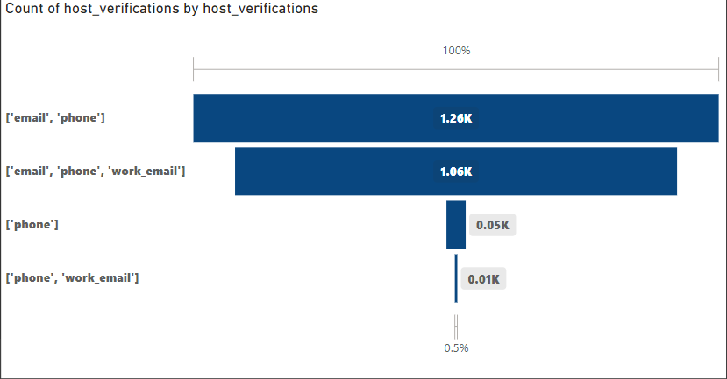
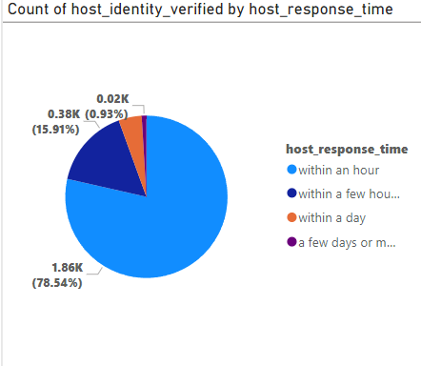
Host Performance

Slide 8
Host Performance Insights
This pie chart depicts the count of hosts who have verified their identity, categorized by their response time.
Insights:
Majority Response Time:
Within an hour: The majority of hosts (78.54%, or 1.86K) respond within an hour. This indicates that most hosts are highly responsive, which is likely beneficial for guest satisfaction and prompt communication.
Other Response Times:
Within a few hours: 15.91% (0.38K) of hosts respond within a few hours, showing a moderate level of responsiveness.
Within a day: 0.93% (0.02K) of hosts respond within a day.
A few days or more: Very few hosts (less than 1%) take a few days or more to respond, suggesting that such delayed responses are uncommon.
This horizontal bar chart displays the count of host verifications, categorized by the type of verification methods used.
Insights:
Common Verification Combinations:
Email and Phone: The most common combination, with 1.26K hosts verifying their identity using both email and phone.
Email, Phone, and Work Email: The second most common, with 1.06K hosts using these three methods for verification.
Less Common Verifications:
Phone only: Only 0.05K hosts use phone verification alone.
Phone and Work Email: The least common, with just 0.01K hosts using this combination.

Slide 9
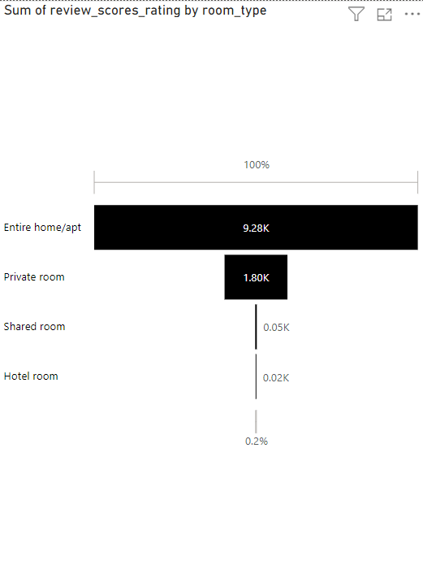
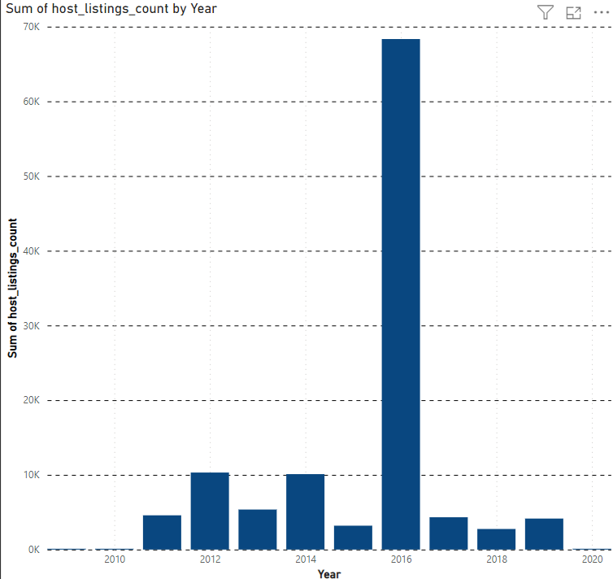
Review Scores and Guest Satisfaction

Slide 10
Review Scores and Guest Satisfaction
Sum of Review Scores by Room Type:
Entire home/apt: This category has the highest sum of review scores, totaling 9.28K. This indicates that entire homes or apartments are highly favored by guests, contributing the most to the overall review scores.
Private room: This category has the second-highest sum of review scores, with 1.80K. It shows a significant drop compared to entire homes/apartments.
Shared room and Hotel room: These categories have very low review scores, with shared rooms at 0.05K and hotel rooms at 0.02K. This suggests that these options are the least popular among guests.
2. Sum of Host Listings Count by Year:
2016 Peak: There is a dramatic peak in the number of host listings in 2016, with counts reaching approximately 65K. This year stands out significantly compared to other years.
Steady Growth and Decline: Other years show a relatively steady growth in listings from 2010 to 2015, a sharp decline after 2016, and some stability or slight growth from 2017 to 2020.

Slide 11
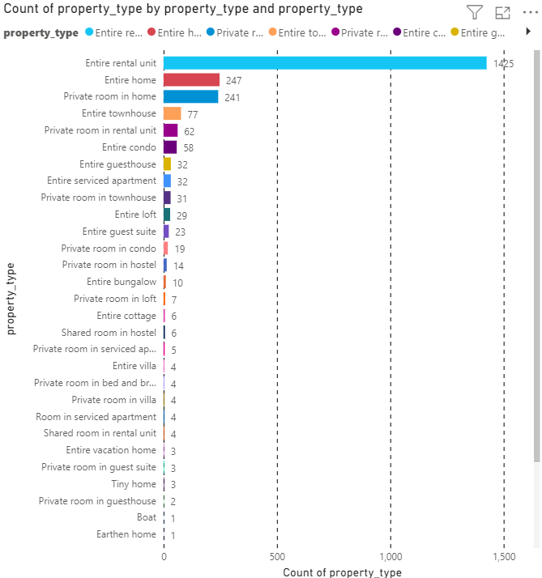
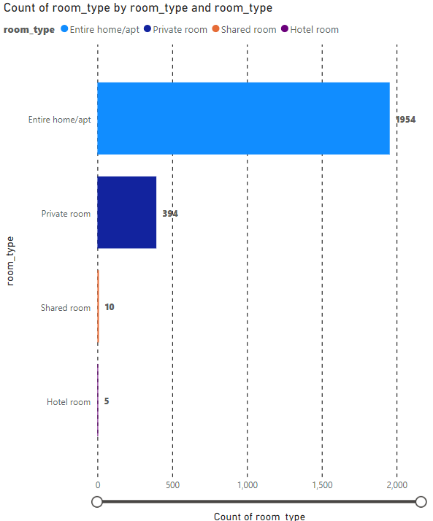
Property Type and Room Analysis

Slide 12
Property And Room Type Insights
Dominance of Entire Home/Apt: The "Entire home/apt" category has the highest count by far, with 1,954 listings. This indicates that the majority of hosts prefer to list entire homes or apartments rather than shared or individual rooms.
Significant Presence of Private Rooms: The "Private room" category has 394 listings, which is significantly fewer than entire homes/apts but still considerable. This suggests a substantial number of hosts and guests are interested in private room accommodations.
Scarcity of Shared and Hotel Rooms: "Shared room" and "Hotel room" categories have very low counts, with 10 and 5 listings respectively. This shows that these types of accommodations are much less common on Airbnb.
Most Common Property Type: Entire rental unit is the most common property type by a large margin, with 1,425 listings. This indicates a high demand or supply for such units, suggesting they are popular among renters.
Other Popular Property Types: Entire home and private room in home are also popular, with 247 and 241 listings respectively. These options are likely preferred by renters who want more privacy or are looking for cost-effective alternatives.
Moderately Common Property Types: Entire townhouse, private room in rental unit, entire condo, and entire guesthouse are other significant categories, with counts ranging from 62 to 32 listings. These property types cater to a variety of renter preferences, such as more space or specific amenities.

Slide 13
Recommendations
1
Focus on High-Demand Areas:
2
Host Support and Training:
Increase listings and marketing efforts in Brunswick, Southbank, and Richmond, as these areas show high host activity and demand.
Consider expanding into adjacent neighborhoods to capture spillover demand from popular areas.
Provide support and training for hosts in high-demand areas to improve service quality and guest experience.
Encourage hosts to adopt best practices identified from data analysis to enhance overall listing performance.
3
Encourage Faster Response Times:
4
Sustain Growth Post-2016:
Since the majority of hosts respond within an hour, it's beneficial to promote this behavior as a standard. Encourage hosts to maintain or improve their response times through reminders and incentives.
Implement features like auto-responses or chatbots to assist hosts who might not be able to respond immediately.
Post-2016, there has been a decline and then stabilization in host listings. Efforts should be made to identify the causes of this decline and work towards sustaining or increasing growth.
This could involve improving host support, offering incentives for new hosts, and ensuring regulatory compliance to prevent drops in listings.

